Slide 1
Gram 3D image generation from stereoscopic vision
By
S.SRIHARI
[17BCE1308]

Slide 2
Stereoscopic vision
three-dimensional vision produced by the fusion of two slightly different views of a scene on each retina

Slide 3
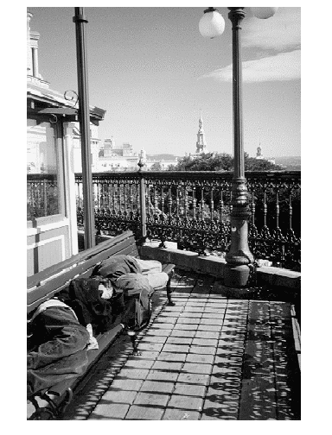
We neeed to determine
1. the sizes of objects
2. the distances of objects from the camera?
What knowledge
do we use to
analyze this image?

Slide 4
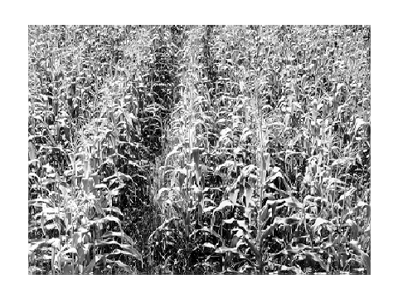
What objects are shown in this image?
How can we estimate distance from the camera?
What feature changes with distance?

Slide 5
Visual Cues for 3D
Shading
Texture
Focus
Motion

Slide 6
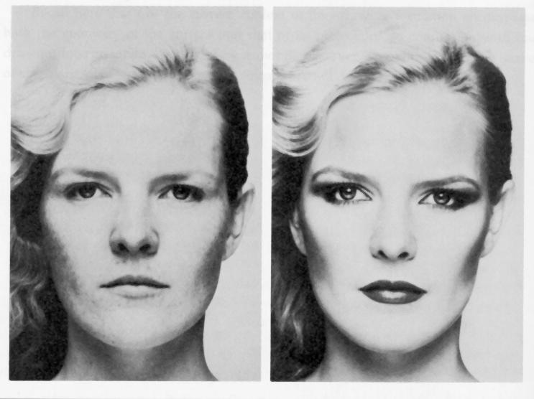
Shading - Example

Slide 7
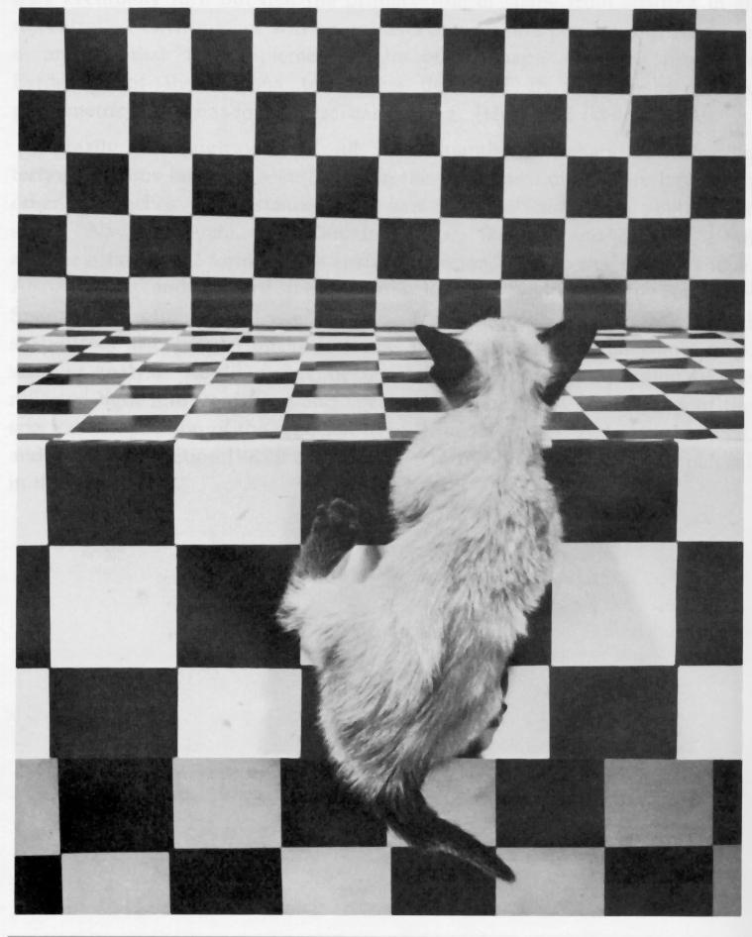
Texture – Example [ Visual Cliff]

Slide 8


Focus - Example

Slide 9
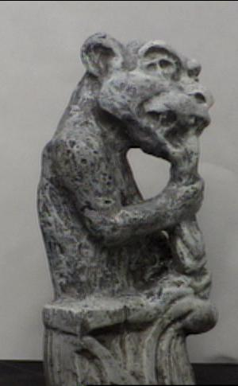
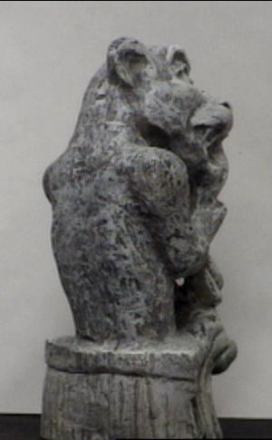
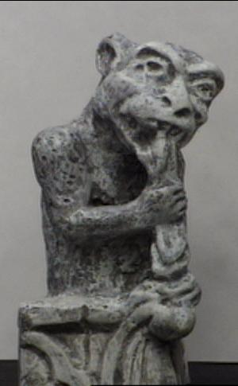
Motion - Example

Slide 10
Stereo Reconstruction
The Stereo Problem
Shape from two (or more) images
known
camera
viewpoints

Slide 11
Perspective Imaging Model: 1D
real image
point
This is the axis of the
real image plane.
E
xi
f
camera lens
O is the center of projection.
O
image of point
B in front image
D
This is the axis of the front
image plane, which we use.
zc
xf
xi xc
f zc
=
xc
B
3D object
point

Slide 12
Perspective in 2D (Simplified)
Yc
camera
P´=(xi,yi,f)
Xc
3D object point
yi
P=(xc,yc,zc)
=(xw,yw,zw)
ray
f
F
xi
yc
optical
axis
zw=zc
xi xc
f zc
=
xi = (f/zc)xc
yi = (f/zc)yc
Zc
xc
Here camera coordinates
equal world coordinates.
yi yc
f zc
=

Slide 13
3D from Stereo
3D point
left image
right image
disparity: the difference in image location of the same 3D
point when projected under perspective to two different cameras.
d = xleft - xright

Slide 14
Depth Perception from Stereo Simple Model: Parallel Optic Axes
image plane
z
Z
camera
L
f
xl
baseline
b
f
camera
R
xr
x-b
X
P=(x,z)
z x
f xl
z x-b
f xr
z y y
f yl yr
y-axis is
perpendicular
to the page.
=
=
=
=

Slide 15
Resultant Depth Calculation
For stereo cameras with parallel optical axes, focal length f,
baseline b, corresponding image points (xl,yl) and (xr,yr)
with disparity d:
z = f*b / (xl - xr) = f*b/d
x = xl*z/f or b + xr*z/f
y = yl*z/f or yr*z/f
This method of
determining depth
from disparity is
called triangulation.

Slide 16
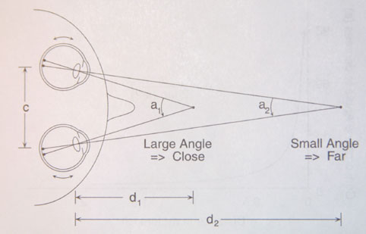

Depth from Convergence – perception of human eyes

Slide 17
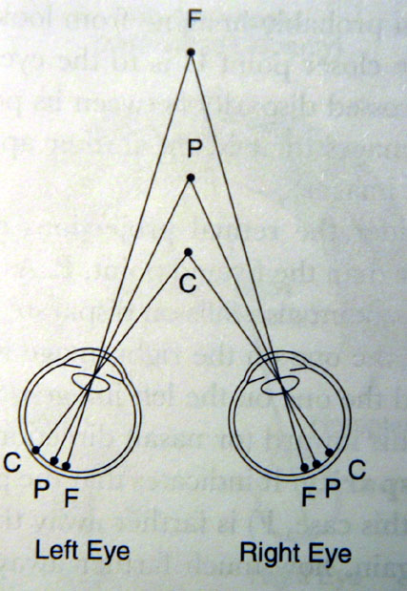
Depth from binocular disparity
P- converging poiint
C: object nearer projects to the outside of the P, disparity = +
F: object farther projects to the inside of the P, disparity = -

Slide 18
Finding Correspondences
If the correspondence is correct,
triangulation works VERY well.
But correspondence finding is not perfectly solved.
for the general stereo problem.
For some very specific applications, it can be solved
for those specific kind of images, e.g. windshield of
a car.
°
°

Slide 19
3 Main Matching Methods
1. Cross correlation using small windows.
2. Symbolic feature matching, usually using segments/corners.
3. Use the newer interest operators, ie. SIFT.
dense
sparse
sparse

Slide 20
Binocular Stereo
scene point
image plane
optical center

Slide 21
Binocular Stereo
Basic Principle: Triangulation
Gives reconstruction as intersection of two rays
Requires
calibration
point correspondence

Slide 22
Stereo Correspondence
Determine Pixel Correspondence
Pairs of points that correspond to same scene point
epipolar line
epipolar line
epipolar plane
Epipolar Constraint
Reduces correspondence problem to 1D search along conjugate epipolar lines

Slide 23
Constraints
1. Epipolar Constraint:
Matching points lie on
corresponding epipolar
lines.
2. Ordering Constraint:
Usually in the same
order across the lines.
P
Q
e2
e1
C1
C2

Slide 24
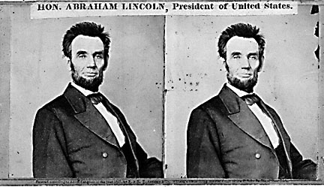
Basic Stereo Algorithm
For each epipolar line
For each pixel in the left image
compare with every pixel on same epipolar line in right image
pick pixel with minimum match cost
Improvement: match windows
This should look familiar...
Correlation, Sum of Squared Difference (SSD), etc.

Slide 25
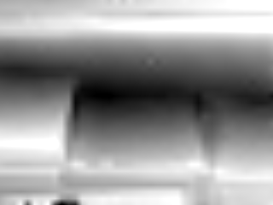
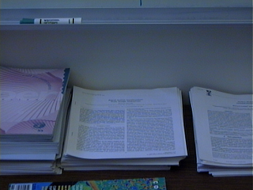
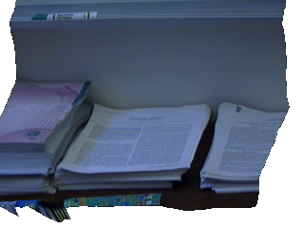
Stereo Example
input image (1 of 2)
depth map
3D rendering

Slide 26


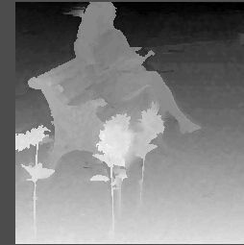
Stereo example 2
left image
right image

Slide 27
Thank You

